Slide 1

Amtrak Rail Station Network
Tanner Kogel

Slide 2
Overview
Objective
Graph Generation
Analysis & Discussion

Slide 3

Objective
Study the interconnectedness of populous U.S. cities by use of Amtrak rail travel
Three Networks:
Amtrak Rail Stations
Populous U.S. Cities (Induced)
Populous U.S. Cities (Non-Induced)

Slide 4

Graph Generation
Amtrak Rail Station Network
Node definition: Rail station utilized by Amtrak
Edge exists if: Amtrak route between two stations exists
Weighted and Undirected

Slide 5
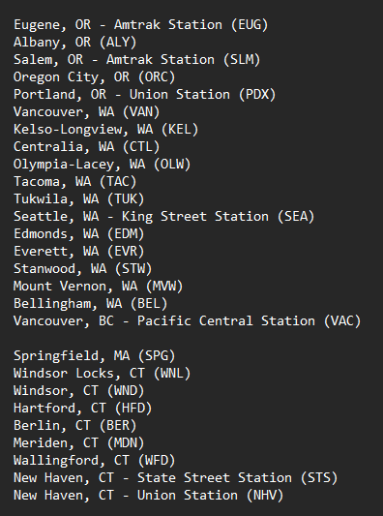
Graph Generation
Amtrak Rail Station Network
Obtain .txt file from Amtrak website
Parse data to write GML file
Route #1
Break
Route #2

Slide 6
Graph Generation
Amtrak Rail Station Network
Obtain .txt file from Amtrak website
Parse data to write GML file
530 Nodes
592 Edges

Slide 7
Graph Generation
Populous U.S. City Network
Node definition: City estimated to have a population of 100,000 or greater by July 1, 2021, as estimated by the 2020 U.S. Census

Slide 8
Graph Generation
Populous U.S. City Network
Obtain .txt file of census data
Parse data to obtain nodes
Map Amtrak network to city network
331 Nodes
Induced
Non-Induced

Slide 9
Graph Generation
Populous U.S. City Network (Induced)
Edge exists if:
Edge exists in Amtrak Network
Both adjacent stations are within a defined city
“Direct-Route” Graph
331 Nodes
74 Edges
Populous U.S. City Network (Non-Induced)
Edge exists if:
Amtrak route travels between adjacent cities without passing through any other defined cities
“Destinations” Graph
331 Nodes
163 Edges

Slide 10


Graph Generation
Induced Graph
Populous U.S. City Network Mappings
Springfield, MA
Hartford, CT
New Haven, CT
Non-Induced Graph
Springfield, MA
Hartford, CT
New Haven, CT

Slide 11
Analysis
Components & Diameter
Assortativity
Centrality
Degree Distribution

Slide 12
Components & Diameter
 | Amtrak Network | Non-Induced Graph | Induced Graph
Components | 3 | 204 | 272
Diameter | 81 | 30 | 7
Path | San Diego…Miami | San Diego…Miami | Irvine, CA…Ontario, CA
Discuss
Why do the sampled graphs have so many more components?
Why is the diameter of the original graph so large?
Structure of transportation networks
Why do the original graph and the non-induced graph’s diameter span the continent, but the induced graph stays within California?

Slide 13
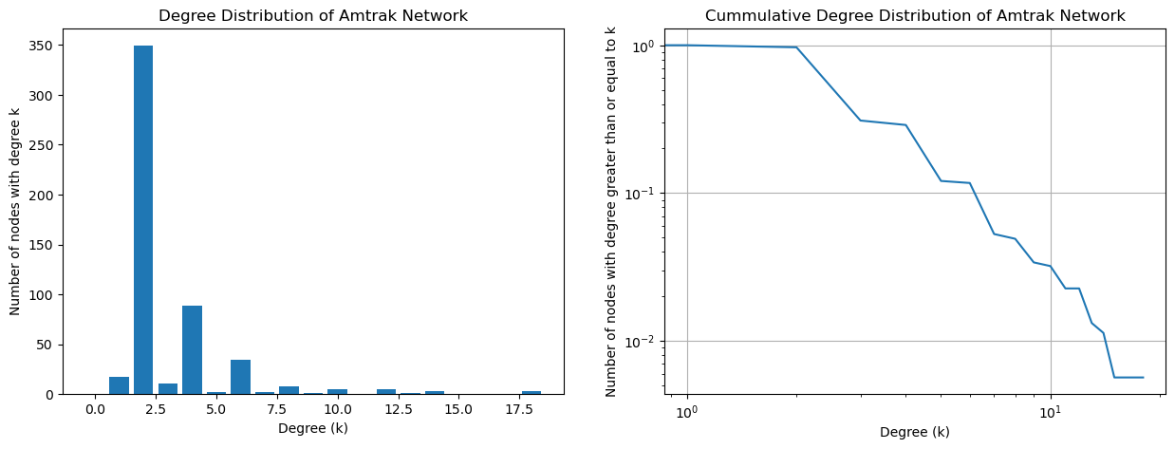
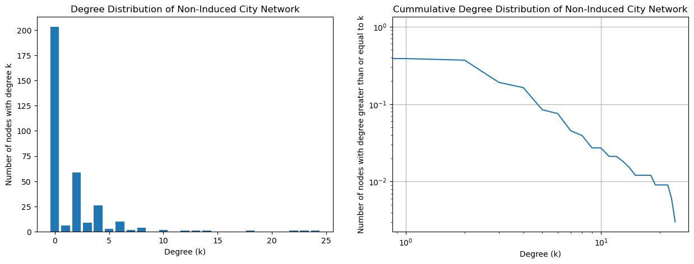
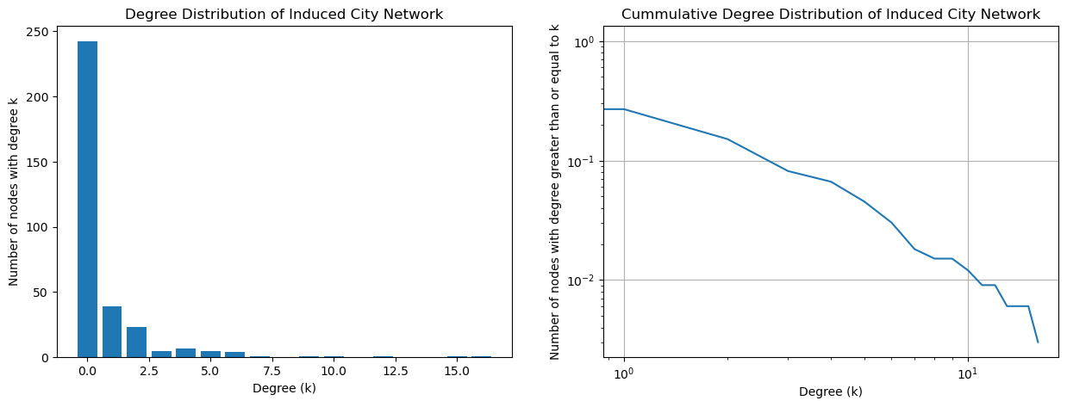
Degree Distribution
Even Degreed Nodes > Odd Degreed Nodes
All nodes have degree > 0
242 nodes with degree 0
Nodes whose neighbors were not included in the sample
Odd/Even pattern not shown
203 nodes with degree 0
Cities that do not have train stations
Odd/Even Pattern Shown
Higher Degrees?
Self Edges

Slide 14
Assortativity
Are cities more likely to be connected if they have similar ______?
State
Population
Geographical Area
Change in Population

Slide 15

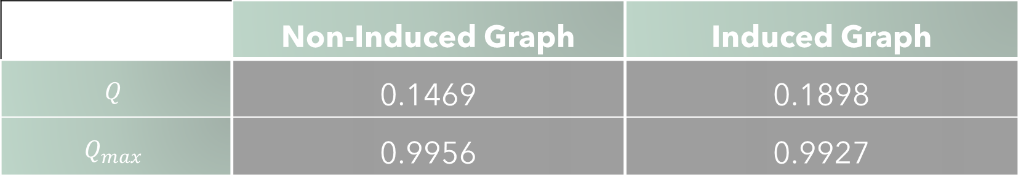
Assortativity by State
 | Non-Induced Graph | Induced Graph
$$Q$$ | 0.1469 | 0.1898
$$Q_{max}$$ | 0.9956 | 0.9927
Discuss
Both are assortatively mixed
Trains travel between big cities in the same state more often than different states
$Q_{max}≈1$
Graph could be almost perfectly assortatively mixed
Number of routes that cross a given states border is roughly even

Slide 16
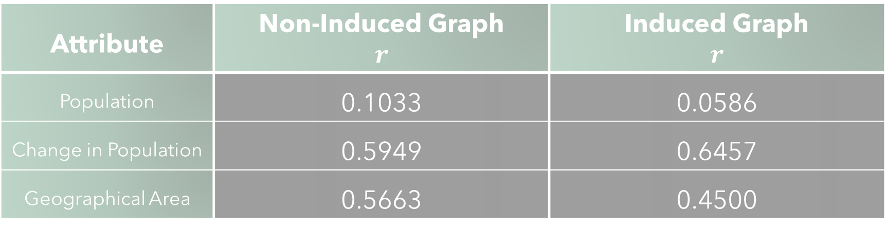
Scalar Assortativity
Attribute | Non-Induced Graph $$r$$ | Induced Graph $$r$$
Population | 0.1033 | 0.0586
Change in Population | 0.5949 | 0.6457
Geographical Area | 0.5663 | 0.4500
Discuss
All attributes are assortatively mixed. Why?
Why is change in population the most assortatively mixed?
Geographical proximity?
Why does it make sense for the non-induced graph to be more assortatively mixed by population than the induced graph?

Slide 17
Eigenvector Centrality
Rank ‘importance’ of nodes based on the number of connections to other nodes
But connections are more ‘important’ if the other node is ‘important’
Meaning for our Network:
Ranking of cities or train stations by number of route options available from the current city or train station as well as its neighbors

Slide 18
Eigenvector Centrality
Rank | Amtrak Network | Non-Induced Graph | Induced Graph
1 | Philadelphia, PA - William H. Gray III 30th St. Station (PHL) - 0.4774 | Philadelphia, PA - 0.5961 | Newark, NJ - 0.7522
2 | Trenton, NJ (TRE) - 0.4508 | Newark, NJ - 0.5674 | New York, NY - 0.6098
3 | Newark, NJ - Penn Station (NWK) - 0.3694 | Baltimore, MD - 0.4506 | Yonkers, NY - 0.2293
4 | Wilmington, DE (WIL) - 0.3638 | New York, NY - 0.2817 | Stamford, CT - 0.0956
5 | New York, NY - Moynihan Train Hall (NYP) - 0.2574 | Washington, DC - 0.1714 | New Haven, CT - 0.0180
6 | Baltimore, MD - Penn Station (BAL) - 0.2058 | Yonkers, NY - 0.0714 | Bridgeport, CT - 0.0171
7 | Metropark, NJ (MET) - 0.1852 | Alexandria, VA - 0.0443 | Providence, RI - 0.0014
8 | North Philadelphia, PA (PHN) - 0.1525 | Stamford, CT - 0.0431 | Baltimore, MD - 0.0005
9 | Cornwells Heights, PA (CWH) - 0.1472 | Pittsburgh, PA - 0.0386 | Washington, DC - 0.0003
10 | Newark, NJ - Liberty International Airport (EWR) - 0.1354 | Boston, MA - 0.0206 | Alexandria, VA - 0.0001

Slide 19
Betweenness Centrality
Rank nodes by how common it is for paths to pass through them
Meaning for our Network:
Ranking of cities or train stations by the likelihood that any trip planned will make a stop at that city or train station

Slide 20
Betweenness Centrality
Rank | Amtrak Network | Non-Induced Graph | Induced Graph
1 | Chicago, IL - Union Station (CHI) - 0.5779 | Chicago, IL - 0.0896 | Fullerton, CA - 0.0007
2 | Cleveland, OH (CLE) - 0.3454 | Naperville, IL - 0.0707 | Los Angeles, CA - 0.0006
3 | South Bend, IN (SOB) - 0.2986 | Alexandria, VA - 0.0474 | Anaheim, CA - 0.0003
4 | Elkhart, IN (EKH) - 0.2973 | Indianapolis, IN - 0.0406 | Riverside, CA - 0.0003
5 | Waterloo, IN (WTI) - 0.2965 | Greensboro, NC - 0.0400 | Oakland, CA 0.0002
6 | Toledo, OH (TOL) - 0.2947 | Greensboro, NC - 0.0400 | Santa Ana, CA - 0.0002
7 | Sandusky, OH (SKY) - 0.2939 | Omaha, NE - 0.0348 | San Bernardino, CA - 0.0002
8 | Elyria, OH (ELY) - 0.2930 | Cleveland, OH - 0.0335 | Pomona, CA - 0.0002
9 | Sacramento, CA - Sacramento Valley Station (SAC) - 0.2827 | Lincoln, NE - 0.0334 | New York, NY - 0.0002
10 | Naperville, IL (NPV) - 0.2810 | Denver, CO - 0.0320 | San Jose, CA - 0.0002

Slide 21
Conclusion
Does the Amtrak network do a good job of connecting major cities?
No
Multiple Components
Large Diameter
Do either of the sampled networks accurately reflect the original?
Non-Induced
Maybe, a lot of important information is missing, and it is usually better to use the original network since it is small enough to be analyzed easily, but it was accurate enough to give useful information for assortativity
Induced
No, too much information is missing such that it does not reflect the behavior of the original graph in any of the analysis

Slide 22
Questions?

